Slide 1
Week 9
A bunch of stuff
Visibility, height, width, overflow, units, float
Positioning- static, absolute, relative, fixed, sticky
Media queries
Custom properties

Slide 2
display
display

Slide 3
Stuff
Display: block, inline, inline-block
Visibility: hidden, visible
Opacity: 0-1
Min-height, max-height (and width)
Flow: left, right
Overflow: hidden, scroll

Slide 4
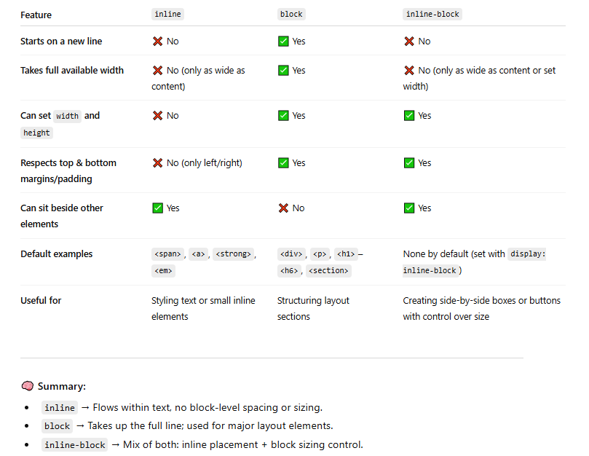
Display

Slide 5
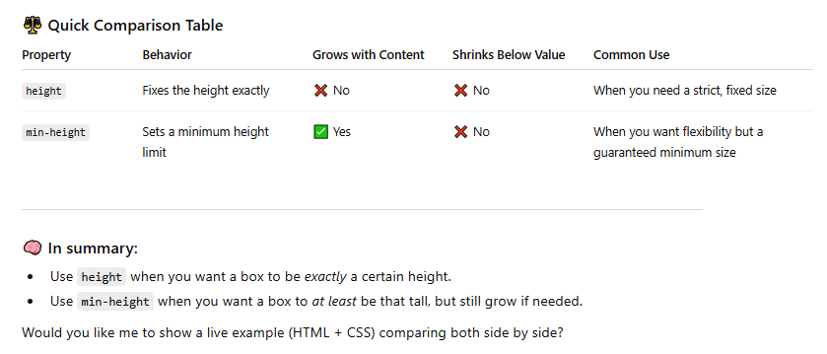
Min-height, min-width

Slide 6
Containers
Unless we explicitly act on containers by setting width/height, min-width/height etc, a container will grow and shrink to accommodate its contents.
If there we set all of the content inside the container to visible: hidden, the container will shrink to nothing. It is still there but it has no dimension.

Slide 7
Basic Positioning
CSS Positioning

Slide 8
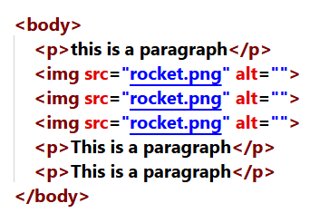
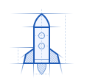
This is a paragraph
This is a paragraph
How elements flow onto the page:
Each element is assigned a slot
Slots are arranged based on block or inline
Each element goes into its slot
This is a paragraph
Static is the default. It is what we’ve been using since the beginning of the course. There is a slot for the element on the page and the element slides right into the slot. Easy!
Every element has a position property:
static (default)
relative
absolute
fixed
sticky

Slide 9
CSS Positioning
relative

Slide 10
This is a paragraph
This is a paragraph
How elements flow onto the page:
Each element is assigned a slot
Slots are arranged based on block or inline
Each element goes into its slot
This is a paragraph
Relative:
Still has the slot for our element.
However, now we can offset our element based on the slot.
Remember, the Slot still exists so that space is still taken up on the webpage!
Notice that no other elements were displaced by this
Every element has a position property:
static (default)
relative
absolute
fixed
sticky

Slide 11
Yourturn1 – Part A

Slide 13
This is a paragraph
This is a paragraph
How elements flow onto the page:
Each element is assigned a slot
Slots are arranged based on block or inline
Each element goes into its slot
This is a paragraph
Absolute:
A lot like relative in that we can offset our element.
However, we don’t have a slot to offset from.
It will become absolute within the first parent container that is not static
The element is placed where the slot would be but there is no slot!
We offset from the container that the element is in.
Remember, the Slot does not exist so that space will NOT be taken up on the webpage!
Every element has a position property:
static (default)
relative
absolute
fixed
sticky

Slide 14
Yourturn1 – Part B

Slide 16
Stays put when scrolling
This is a paragraph
This is a paragraph
How elements flow onto the page:
Each element is assigned a slot
Slots are arranged based on block or inline
Each element goes into its slot
This is a paragraph
Fixed:
Basically, just like absolute but it doesn’t scroll with the rest of the page
Every element has a position property:
static (default)
relative
absolute
fixed
sticky

Slide 17
Yourturn1 – Part C

Slide 19
Scrolls until we hit its position
This is a paragraph
This is a paragraph
How elements flow onto the page:
Each element is assigned a slot
Slots are arranged based on block or inline
Each element goes into its slot
This is a paragraph
Sticky:
Acts like relative until we scroll to its position
Then it acts like fixed
Every element has a position property:
static (default)
relative
absolute
fixed
sticky

Slide 20
Yourturn1 – Part D

Slide 21
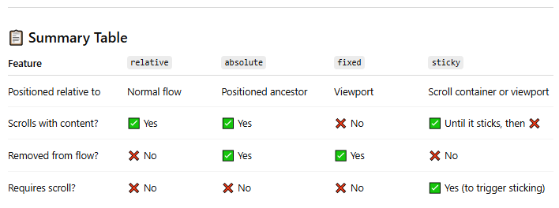
Summary

Slide 22
Z axis

Slide 23
Yourturn1 – Part E

Slide 24
Positioning
static: Default one.
relative : Same as static. But lets you add top, right, bottom, left. Makes it move relative to its normal position
absolute: Removes from the flow and positions absolute wrt to the parent. Parent has to be not static for top, right, bottom, left to work. Else it considers the main html element as the parent .
fixed : Fixed to a place. Doesn't give two shits about the parent. Always considers html element as the parent. Stays there when scrolled.
sticky : Relative ( when normal) + fixed ( when scrolled). The values for top, right, bottom, left become active when scrolled

Slide 25
Media Queries
How do we make our web apps work across many devices?
Think facebook or Instagram.
They work on your phone, tablet, computer, etc.

Slide 26
MediaQueries

Slide 27
Bringingittogether

Slide 28
YourTurn2 – Let’s do the first one together

Slide 29
Custom properties

Slide 30
Yourturn 3 – Go back to yourturn 2 and use custom properties to improve the readability and maintainability of your code

Slide 31
A bit of fun

Slide 32
IC9

Slide 33
End

